Slide 1
SMART MIRROR

Slide 2
INDEX
COMPANY PORTFOLIO
INDEX
1. INTRODUCTION
2. DESIGN LAYOUT
3. SOFTWARE SETUP
4. HARDWARE SETUP

Slide 3
INTRODUCTION Artificial Intelligence:- Artificial intelligence (AI) is an area of computer science that emphasizes the creation of intelligent machine which work and react like humans. Some of the activities computers with artificial intelligence are designed to include:
Learning
Planning
Problem Solving
Perception
Manipulating
Speech recognition
Applications of Artificial Intelligence:-
Image Recognition:- The way image recognition works, typically, involves the creation of a neural networks that process the individual pixels of an image. Researchers feed these network as many pre-labelled images as they can, in order to “teach” them how to recognize similar images. This is incredibly important for robots that need to quick and accurately recognize and categorize different objects in their environment
Driverless cars, Charter recognition, videos surveillance

Slide 4
Speech Recognition:-
Speech recognition is the translation of spoken words into text. In speech recognition spoken words. The Measurements in this application might be set of numbers that represent the speech signal. We can segment the signal into portions that contains distinct words or phonemes. In each segment, we can represent the speech signal by the intensities or energy in different time-frequency bands.
Speech recognition applications include voice user interface such as voice dialing, call routing, application control.
Search Engine Result Refine:-
Google and other search engines use machine learning to improve the search results for you. Every time you execute a search, the algorithms at the backend keep a watch at how you respond to the results. If you open top results and stay on the web page for long, the search engine assumes that the result is displayed were in according to the query.
Product Recommendations:-
You shopped for a product online few days back and then you keep receiving emails for shopping suggestions.
Emails Spam and Malware Filtering:-
You can mark a message as spam, it goes into a hopper with millions of messages that others have flagged. AI based algorithm analyze these messages to find similar characteristics, such as word proximity or misspelling that show up frequently in spam.

Slide 5
Social Media Services:-
From personalizing your news feed to better ads targeting, social media platforms are utilizing machine learning for their own and user benefits. Here are a few examples that you must be noticing, using, and loving in your social media accounts, without realizing that these wonderful features are nothing but the application of machine learning.
Online Customer Support:-
A number of websites nowadays offer the option to chat with customer support representative while they are navigating within the site. However, not every website has live executive to answer queries. In most of the cases, you talk to a chatbot. These bots tend to extract information from the website and present it in to the customers.
Online Fraud Detection:-
Machine learning is potential to make cyberspace a secure place and tracking monetary frauds online is one of its examples. For example: Paypal is using Machine Learning for protection against money laundering.
Predictions:-
Traffic Prediction: We all have using GPS navigation services. While we do that, our current locations and velocities are being saved at a central server for managing traffic this data is then used to build a map of current traffic. While this helps in preventing and does congestion analysis, the undelaying problem is that there less no. of cars that are equipped with GPS. Machine learning in such scenarios helps to estimate the regions where congestion can be found on the basis of daily experiences.

Slide 6
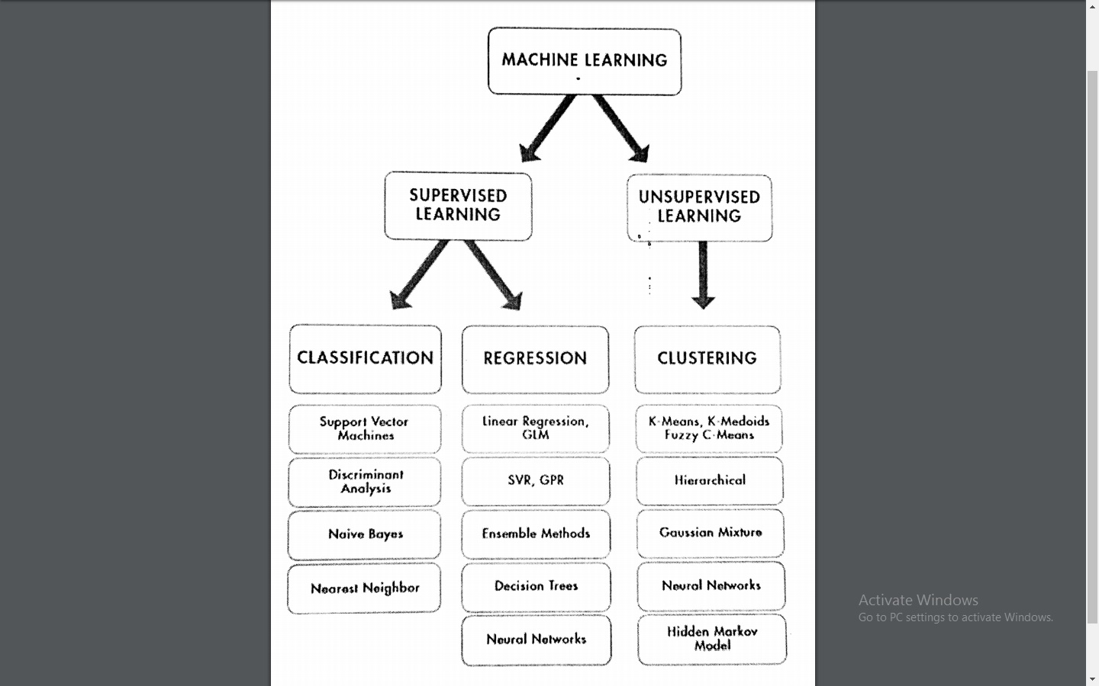
Introduction to Algorithms of Artificial Intelligence

Slide 7
Virtual Personal Assistance:-
Google assistance, Apple sir, Samsung Bixby, Amazon Alexa and Windows Cortana are some of the popular examples of virtual personal assistants.
How Does Artificial Intelligence works:-
Artificial Intelligence – the concept of machine being able to carry out task in a way that we would consider “Smart” – is implemented with the help of Machine Learning
Machine Learning:-
Machine learning is an application of artificial intelligence (AI) that provides systems the ability to automatically learn and improve from experience without being explicitly programmed.
How does Machine Learning work?
Machine learning uses two types of technique they are:
Supervised Learning:- Supervised learning is a type of machine learning algorithm that uses a known dataset (called the training dataset) to make predictions. The training dataset includes input data and response values. Supervised Learning uses classification and regression techniques
Unsupervised Learning:- Unsupervised learning is a type of machine learning algorithm used to draw inferences from datasets consisting of input data without labeled responses. The most common unsupervised learning method is cluster analysis, which is used for exploratory data analysis to find hidden patterns or grouping in data.

Slide 8
INTRODUCTION
COMPANY PORTFOLIO
What is Smart Mirror
Smart mirrors are straight from science fiction. They’re part of an optimistic vision of the future that imagines a world where screens and data are everywhere, ready to feed you whatever information you need at a moment’s notice. Basically, the mirror looks like a normal mirror but when someone stands in front of it the scene changes. The mirror provides a functional, user friendly and interactive UI to its user for accessing their health information, live location etc. It has widgets for displaying the current weather conditions and time. The Smart Mirror would help in developing smart houses with embedded artificial intelligence, as well as sharing its applications in various industries.
The raspberry pi is programmed using python and connects to a monitor with an inbuilt speaker so as to provide an onscreen interface and voice assistance as well. Section 2 focuses on Design of mirror. The working while making Smart Mirror is covered under Section 3. Section 4 comments on the Functional Overview of mirror. Section 5 covers problems and issues that may occur while development.

Slide 9
What Can A Smart Mirror Do?
What makes a Smart Mirror ‘smart’ is the ability to display any information you want on it. A smart mirror can be customized to display local weather forecasts, news bulletins, your upcoming calendar schedule, social media feeds, etc.
It’s possible to even add voice commands using Amazon’s Alexa or Google’s Home Assistant.
How Do Smart Mirrors Work?
There are three components of a smart mirror:-
A Two-Way Mirror
A Display
A Computer device
How These Components Helps To Run Smart Mirror
A Two-way Mirror:- Two-Way Mirror: A normal mirror has a film behind the glass that reflects 100% of incoming light. This means when you look at a mirror, you see your reflection. A two-way mirror reflects light from one direction, but allows light to pass through from the other direction.
A Display:- Behind the two-way mirror sits a monitor screen/TV/tablet. This is used to display any information or modules for your smart mirror. The display can be the same size as the mirror, or it can be smaller than the mirror.
A computer Device:- Something has to run the content you see on your smart mirror. A small computer device such as a Raspberry Pi is more than enough to power a smart mirror.

Slide 10
Advantages of a Smart Mirror:-
Like many smart devices, it’s hard to imagine how useful they can be until you use one. The big advantage of a smart mirror is the ability to display useful information without needing to open apps or do anything.
You simply look at your smart mirror and the information is there.
For example, imagine the mirror in your bathroom is a smart mirror. Every morning you probably wake up and stand in front of that mirror as you brush your teeth or prepare for the day.
Imagine while you go through your morning routine you can look at your mirror and see a traffic report, weather forecast for the day, and your day’s schedule.
Being able to take in all of this useful information without interrupting your normal routine is very liberating. You can customize your mirror to display anything you find useful.
Want a news feed for specific topics? Easy. Want to see stock price movements? Done. Want a daily quote to inspire you every morning to go for that run? You got it.
A great advantage of building your own smart mirror is the modules and software other people have already built. There are literally hundreds of different modules other people have built you can use for your smart mirror.
You can fully customize your smart mirror by picking and choosing the modules you want to include.

Slide 11
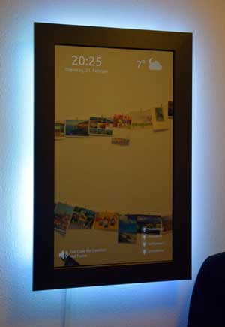
Smart Mirror Features:-
Here are some ideas of different features you could include in your smart mirror:
Touch screen: adding touch to your smart mirror let’s you interact with it
LED lighting: a simple LED strip around your smart mirror can add some nice feature lighting to your room
Motion sensor: turn your smart mirror on automatically when you enter your room
Voice control: ask your mirror questions or give it commands
Facial recognition: your mirror can detect who is in the room and customize the content to match each person

Slide 12
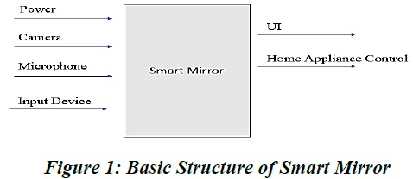
DESIGN LAYOUT
COMPANY PORTFOLIO
Design
Power connection, microphone for voice input, camera for image processing form the basic input devices for the mirror. The monitor and speakers forms the output Design devices of the mirror.
Smart Mirror doesn’t fully display all the equipment that are to be connected to the raspberry pi, but covers all major functional units. The microphone is connected via sound card on USB port of Pi. The camera can be connected to USB port or the Pi camera can be connected to camera slot on Pi. To access the internet the Pi is connected to home Wi-Fi network or with the LAN cable. The programming of the Pi for displaying the UI on the screen is done using Python.

Slide 13
DESIGN LAYOUT
COMPANY PORTFOLIO
WORKING
The working of each components in smart mirror is explained in this section.
1. Two-Way glass mirror
The two-way mirror is what gives the mirror its real identity. It’s really magic mirror as it has reflective surface at one side and also its transparent for light with good intensity. The mirror stays at the front where the user can watch himself/herself in the mirror at the same time the allows the light from monitor to pass through it and make available the UI.
2. Monitor
The monitor is directly connected to Raspberry Pi via HDMI interface thus providing display as well as voice output.
3. Raspberry Pi
The raspberry pi is the most vital part of the mirror, it forms the processing unit of the mirror. The Pi is like motherboard having all the required constituents which forms a great CPU. Its size of a credit card and still it can perform like a full-fledged computer. The programming of Pi is done using Python language. Installation of OS on Raspberry Pi is quite a simple process. First you have to download Raspbian OS which is great OS of Raspberry Pi for beginners. The Raspbian is just a flavor of Debian OS .

Slide 14
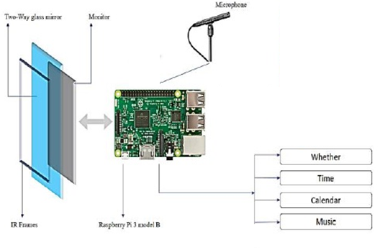
DESIGN LAYOUT
COMPANY PORTFOLIO
4. Microphone
The microphone is used to give voice input to the mirror. Along with touch capability a voice input makes the system very reliable and robust in working. A sensitive microphone takes voice command from the user and processes it to do corresponding action.

Slide 15
LIST OF COMPONENTS
COMPANY PORTFOLIO
Raspberry pi
MicroSD card (min 8GB)
Display
Sound card with Microphone
Two way glass mirror
Internet access
WebCam

Slide 16
SOFTWARE SETUP
COMPANY PORTFOLIO
2. Software Setup
Step 1: Install Raspbian OS
Step 2: Connect to internet
Step 3: Update OS and Install Python and other packages
Step 4: Connect Microphone to Raspberry Pi
Step 5: Create Google Maps API
Step 6: Download and Run Script

Slide 17
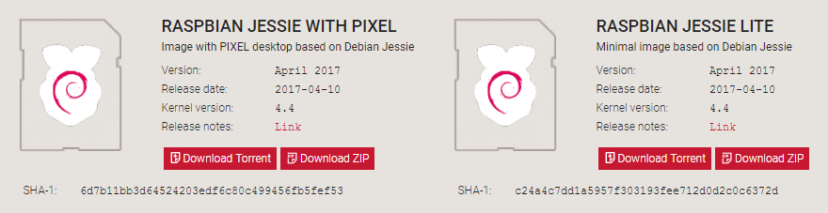
SOFTWARE SETUP
COMPANY PORTFOLIO
Step 1. How to install Raspbian on the Raspberry Pi
Installing Raspbian on the Raspberry Pi is pretty straightforward. We’ll be downloading Raspbian and writing the disc image to a microSD card, then booting the Raspberry Pi to that microSD card. For this project, you’ll need a microSD card (go with at least 8 GB), a computer with a slot for it, and, of course, a Raspberry Pi and basic peripherals (a mouse, keyboard, screen, and power source). This isn’t the only method for installing Raspbian (more on that in a moment), but it’s a useful technique to learn because it can also be used to install so many other operating systems on the Raspberry Pi. Once you know how to write a disc image to a microSD card, you open up a lot of options for fun Raspberry Pi projects.
Step 1.1: Download Raspbian

Slide 18
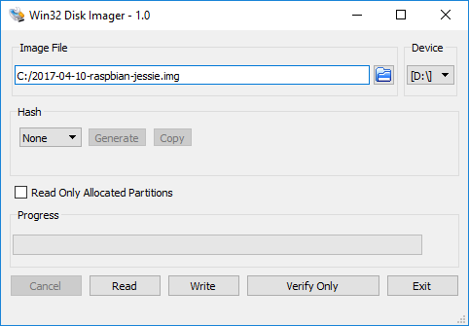
SOFTWARE SETUP
COMPANY PORTFOLIO
First things first: hop onto your computer (Mac and PC are both fine) and download the Raspbian disc image. Give yourself some time for this, especially if you plan to use the traditional download option rather than the torrent. It can easily take a half hour or more to download.
Step 1.2: Unzip the file
The Raspbian disc image is compressed, so you’ll need to unzip it. The file uses the ZIP64 format, so depending on how current your built-in utilities are, you need to use certain programs to unzip it. If you have any trouble, try these programs recommended by the Raspberry Pi Foundation:
Windows users, you’ll want 7-Zip or WinRAR.
Mac users, The Unarchiver is your best bet.
Linux users will use the appropriately named Unzip.
Step 1.3: Write the disc image to your microSD card

Slide 19
SOFTWARE SETUP
COMPANY PORTFOLIO
Next, pop your microSD card into your computer and write the disc image to it. You’ll need a specific program to do this:
Windows users, your answer is Win32 Disk Imager.
Mac users, you can use the disk utility that’s already on your machine.
Linux people, Etcher – which also works on Mac and Windows – is what the Raspberry Pi Foundation recommends.
The process of actually writing the image will be slightly different across these programs, but it’s pretty self-explanatory no matter what you’re using. Each of these programs will have you select the destination (make sure you’ve picked your microSD card!) and the disc image (the unzipped Raspbian file). Choose, double-check, and then hit the button to write.
Step 1.4: Put the microSD card in your Pi and boot up
Once the disc image has been written to the microSD card, you’re ready to go! Put that sucker into your Raspberry Pi, plug in the peripherals and power source, and enjoy. The current edition to Raspbian will boot directly to the desktop. Your default credentials are username pi and password raspberry.

Slide 20
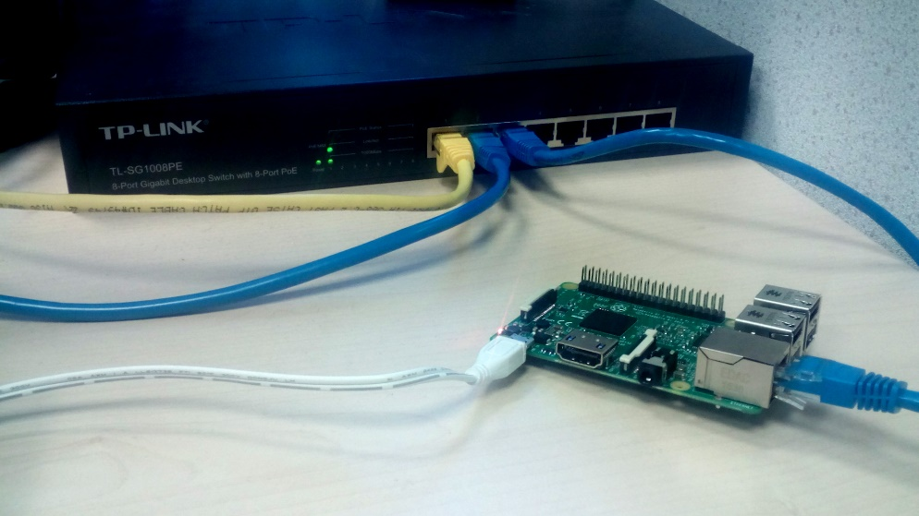
SOFTWARE SETUP
COMPANY PORTFOLIO
Step 2: Connect to internet
Wired Ethernet connection
Consumer routers are usually configured to issue an IP address to your devices via DHCP as soon as they are connected. This means that in most cases, connecting your Pi to the internet via a wired Ethernet connection is as simple as connecting your Raspberry Pi to your internet router/switch with a standard Ethernet cable.

Slide 21
SOFTWARE SETUP
COMPANY PORTFOLIO
Troubleshooting an Ethernet connection
Should you run into an issue on a wired Ethernet connection you should test the connection on your PC/laptop first. If your PC can get an internet connection on a wired Ethernet cable, typically the Pi can too.
Possible issues may include:
A damaged Ethernet cable. This is pretty rare but it can happen.
DHCP may be turned off on your router and because of that your device is not being issued an IP address. Most consumer routers have DHCP enabled by default, so if it is disabled it's quite likely that you have a special networking setup that you are aware of which may require a static address be assigned to your Pi.
If you're connecting through a USB-to-Ethernet adapter instead of default Ethernet port you might run into driver issues if your USB device is not natively supported in your chosen operating system. You may wish to try using the standard Pi Ethernet port first to establish if the issue is general, or is specific to the particular USB device you are using.
A router or general internet fault. If you can't get any internet access via your router (including to your PC/laptop), you may need to replace the router and/or raise the issue with your ISP. They will probably ask the typical question 'have you power cycled it?', so it's worth giving that a shot too.

Slide 22
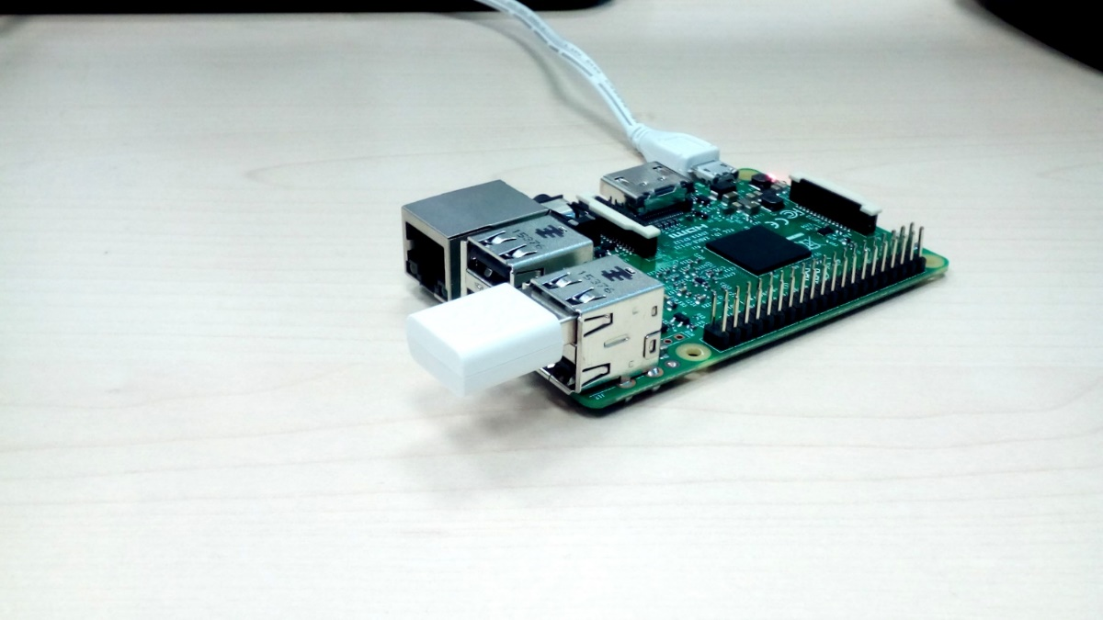
SOFTWARE SETUP
COMPANY PORTFOLIO
Wireless connection
At the time of writing, only Raspberry Pi 3 devices have built in Wifi. For older devices, The WiPy USB Wireless module is available from the Raspberry Pi Store.
Check whether your network is visible and in range
Open a terminal emulator and type in the command below to get a list of networks visible to your Pi:
sudo iw dev wlan0 scan | grep SSID
Configure WiFi
In our case, we set up a network named DATAPLICIT and we will now configure our Pi to connect to it after boot up.
Open up network interfaces file using text editor such as nano.

Slide 23
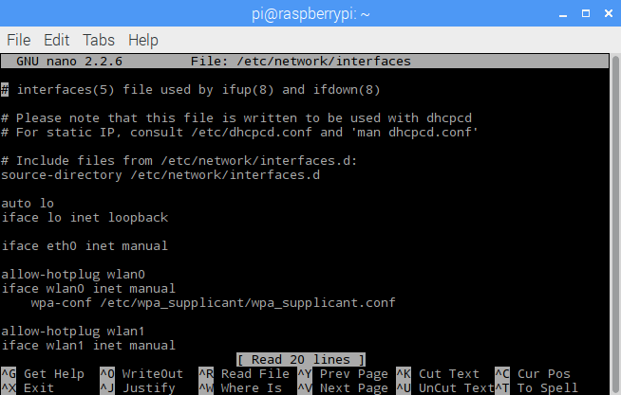
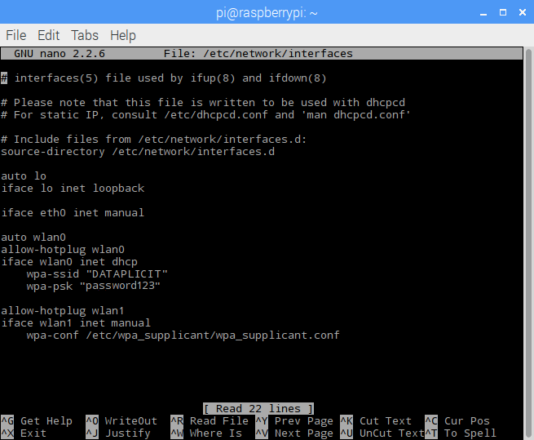
SOFTWARE SETUP
COMPANY PORTFOLIO
Edit network interfaces configuration file
sudo nano /etc/network/interfaces
When you open this file it should look similar to the one shown below.
wlan0 abModifyove to match that which is shown below. You will need to supply your own network name and password instead of DATAPLICIT and password123
Exit the text editor by pressing CTRL + X then y and then ENTER.
All done!
Last thing to do is to reboot the system.
sudo reboot

Slide 24
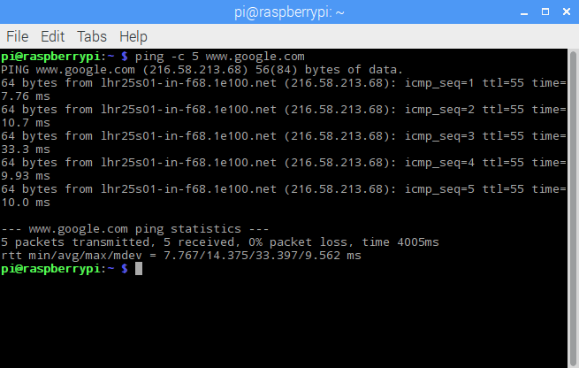
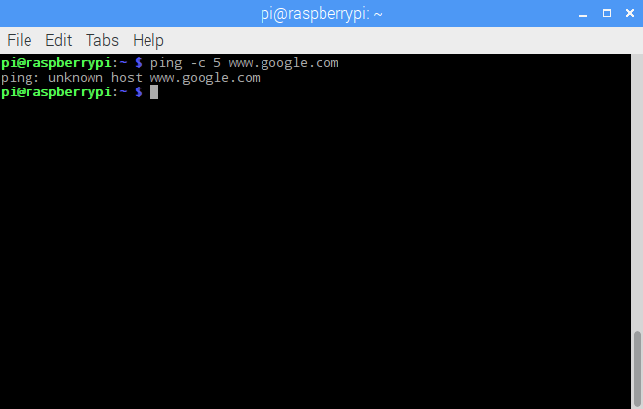
SOFTWARE SETUP
COMPANY PORTFOLIO
Test your connection
You can try to 'ping google.com' to check that your internet connection is working. If this fails, either google.com is broken or your internet connection isn't working, needless to say the latter is more likely. :)
The command below will send 5 packet to google and return connection statistics.
sudo ping –c 5 www.google.com
On successful ping you will see a result similar to the one below.
If your connection isn't working, you will see something similar to the below (or some other error).

Slide 25
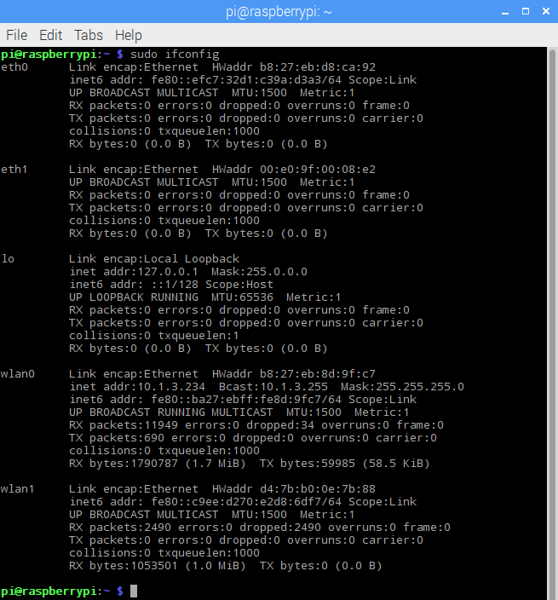
SOFTWARE SETUP
COMPANY PORTFOLIO
Find your IP address
To find the IP of the interfaces on your Raspberry Pi use the command below.
Find IP address of your Pi
sudo ifconfig
You should see a result similar to the one below. To find your IP you have to look at the interface you're currently using e.g. Wlan0 and then look at the inet (IPv4) section.

Slide 26
SOFTWARE SETUP
COMPANY PORTFOLIO
Step 3: Update OS and install python along with the required packages
The first and probably the most important reason is security. A device running Raspbian contains millions lines of code that you rely on. Over time, these millions of lines of code will expose well-known vulnerabilities known as Common Vulnerabilities and Exposures (CVE), which are documented in publicly available databases meaning that they are easy to exploit. Here is a example of a recent CVE found in KODI that provides a bit more insight on what information is available in the database and how CVEs are tracked. The only way to mitigate these exploits as a user of Raspbian is to keep your software up to date, as the upstream repositories track CVEs closely and try to mitigate them quickly.
The second reason, which is related to the first, is that the software you are running on your device most certainly contains bugs. Some bugs are CVEs, but bugs could also be affecting the desired functionality without being related to security. By keeping your software up to date, you are lowering the chances of hitting these bugs.
APT (Advanced Packaging Tool)
To update software in Raspbian, you can use the apt tool in a terminal. Open a terminal window from the taskbar or application menu:

Slide 27
SOFTWARE SETUP
COMPANY PORTFOLIO
First, update your system's package list by entering the following command:
sudo apt-get update -y
Next, upgrade all your installed packages to their latest versions with the following command:
sudo apt-get upgrade -y
sudo apt-get dist-upgrade -y
Updating the kernel and firmware
The kernel and firmware are installed as a Debian package, and so will also get updates when using the procedure above. These packages are updated infrequently and after extensive testing.
Running out of space
When running sudo apt-get dist-upgrade, it will show how much data will be downloaded and how much space it will take up on the SD card. It's worth checking with df -h that you have enough free disk space, as unfortunately apt will not do this for you. Also be aware that downloaded package files (.deb files) are kept in /var/cache/apt/archives. You can remove these in order to free up space with sudo apt-get clean.
Install python3
sudo apt-get install python3
Install Tkinter: For GUI based application
sudo apt-get install python3-tk

Slide 28
SOFTWARE SETUP
COMPANY PORTFOLIO
Step 4: Connect Microphone and test
If you want to be sure that your microphone works well, the easiest way is to do a recording test To do this, launch a terminal and type the following command:
arecord -D plughw:1,0 test.wav
Then open the sound file with your favorite audio player to check that the microphone recorded well your voice
For example:
omxplayer test.wav

Slide 29
SOFTWARE SETUP
COMPANY PORTFOLIO
Step 5: Download the python script and configure it
Change the weather and clock API
Enter the health positive credentials

